Slide 1
Object Detection
CV Project - Team “Kuch bhi”
Team Members:
2018101033 - Jay Sharma
2018102021 - Tanmay Garg
2018102040 - Shantanu Agrawal
2020900019 - Anirudh Polatpally

Slide 2
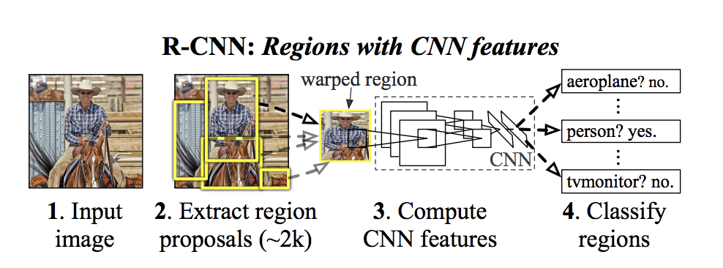
RCNN - Method - Overview
Fig 1: RCNN workflow
Source: [1]

Slide 3
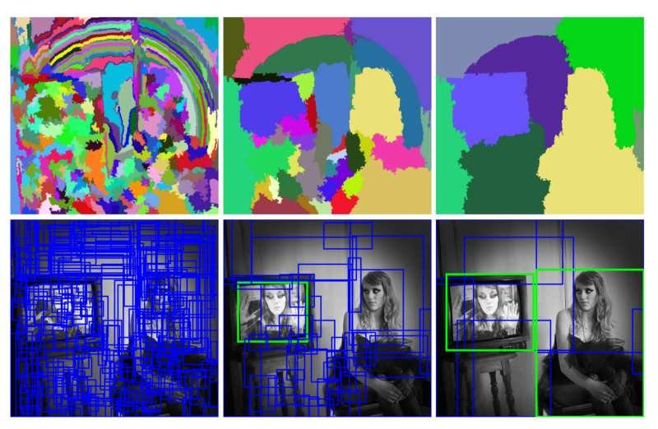
Region Proposals
Used Selective Search Algorithm
Foreground: IoU greater than 0.8
Background: IoU lesser than 0.3
Proposal dimensions - 224, 224, 3
Fig 2: Selective Search at different scales
Source: [2]

Slide 4
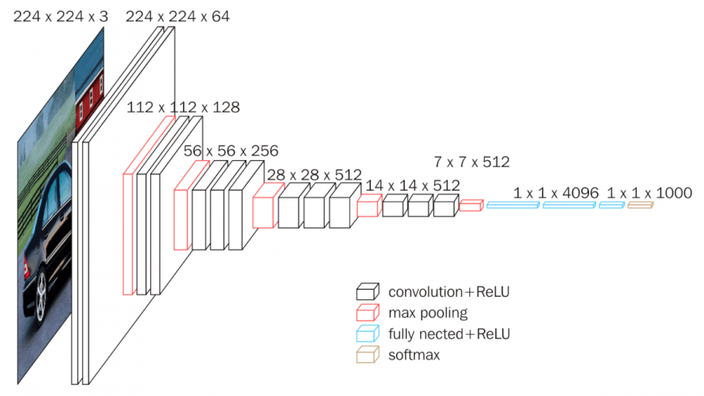
Feature Extraction - CNN
Used VGG-16 as backbone feature extractor.
3×3 convolutional layers stacked on top of each other
Max-pooling to reduce volume in between
Fully Connected layers at the end followed by softmax.
Final layers changed to perform classification and localisation.
Fig 3: VGG16, Source: [3]

Slide 5
Drawbacks of R-CNN
Extremely large amount of time
2 hours per epoch
~8 days for 200 epochs
Prediction time very high (1-2 mins per image)

Slide 6
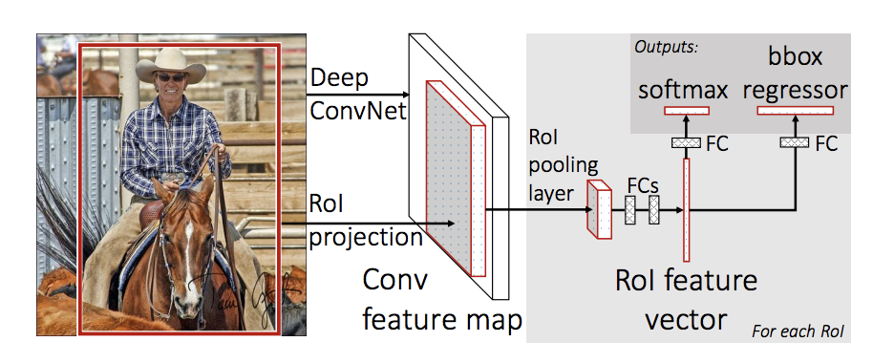
Fast R-CNN
Fig 4: Fast R-CNN, Source: [4]

Slide 7
Fast R-CNN
Directly feed Input image to CNN
Obtain Feature Map
Identify and warp features
Perform RoI Pooling for fixed shape
Predict Class label using Softmax layer
Predict Bounding Box using Bounding Box Regression
Improvement:
Each epoch takes around 60 seconds now
i.e. 3.33 hours per model.
i.e. 20 hours for classification and regression for all 3 models (2*3 = 6 models).

Slide 8
Classification Head
Conv2d(Input Size - N, Output Size - 512)
Flatten
linear(Input Size - 25088, Output Size - 4096)
ReLU
Perform Classification
Final output - scores for each of the classes in consideration (21 in our case)
Dropout - 0.5
linear(Input Size - 4096, Output Size - 4096)
ReLU
Dropout - 0.5
linear(Input Size - 4096, Output Size - Num_Classes)
Fig 4: Classification Head

Slide 9
Regression Head
Conv2d(Input Size - N, Output Size - 512)
Flatten
linear(Input Size - 25088, Output Size - 4096)
ReLU
Perform Bounding Box Regression
Final output - Predicted Bounding Box (4 values)
Dropout - 0.5
linear(Input Size - 4096, Output Size - 4096)
ReLU
Dropout - 0.5
linear(Input Size - 4096, Output Size - 4)
Fig 5: Regression Head

Slide 10
Non Maximum Suppression
Remove multiple bounding boxes
Remove boxes with low confidence
Select a box with highest confidence
Removes lower scoring boxes which have an IoU greater than iou_threshold with the highest scoring box

Slide 11
Training
Obtained feature vectors for each image in training set
Obtained proposals from these vectors using selective search
Trained model using these proposals
Initially trained classification head
Subsequently trained regression head.

Slide 12
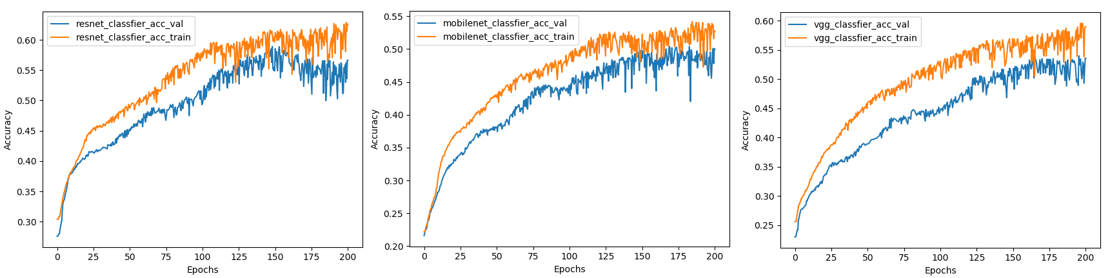
Classification Accuracy Curves

Slide 13
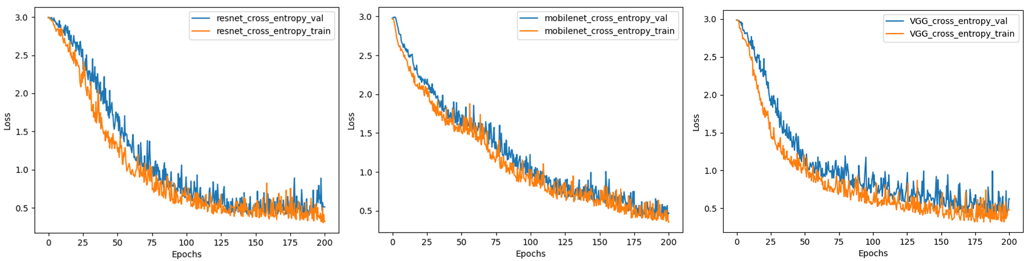
Classification Loss Curves

Slide 14
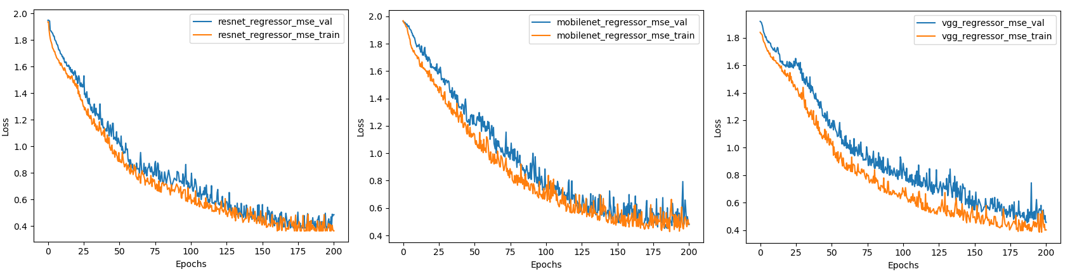
Regression Loss Curves

Slide 15
Metrics
Model Backbone | Train Accuracy | Val Accuracy | Test Accuracy | Classifier Loss (Train) | Classifier Loss (Val) | Regressor Loss (Train) | Regressor Loss (Val) | mAP
Resnet50 | 64.5% | 59.9% | 57.1% | 0.297 | 0.335 | 0.362 | 0.385 | 62.8%
VGG16 | 60.1% | 56.4% | 53.7% | 0.311 | 0.369 | 0.384 | 0.438 | 59.4%
MobileNetV2 | 55.1% | 52.3% | 48.6% | 0.323 | 0.371 | 0.419 | 0.441 | 55.9%

Slide 16
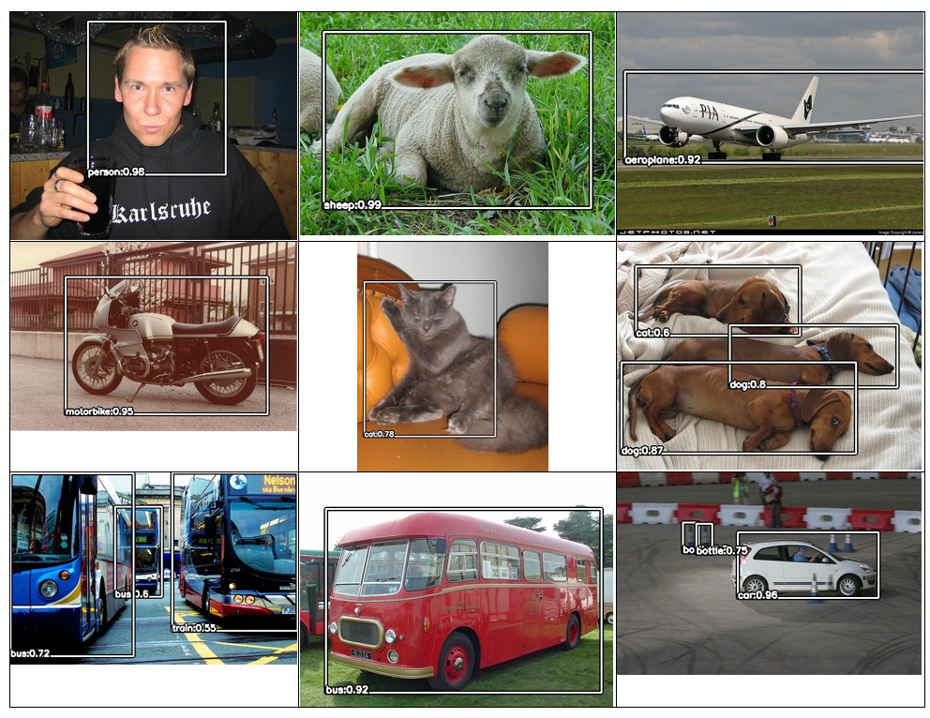
Results

Slide 17
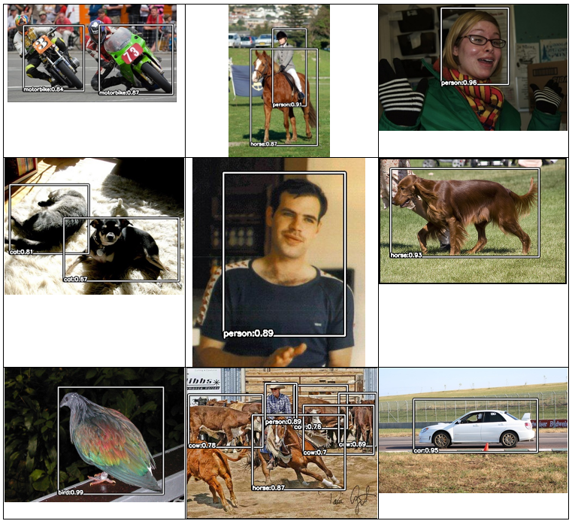
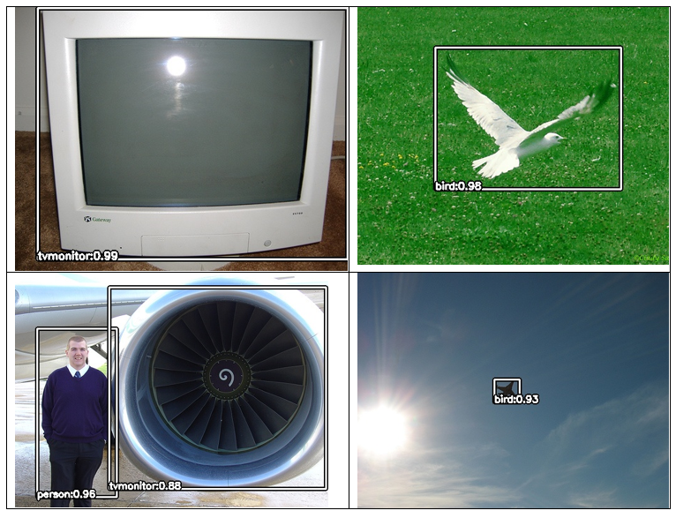
Results

Slide 18
Inferences
We could not not achieve the results as good as the original paper, which can be attributed equally to having less experience with hyper-parameter tuning and limited computational resources.
In general, the results are in the order: Resnet50 > VGG16 > MobileNetV2
Fast RCNN is much more feasible to train compared to RCNN, with no significant hit to accuracy.
Faster RCNN is supposed to even better, but we could not get it to work.

Slide 19
Reference(s)
Rich feature hierarchies for accurate object detection and semantic segmentation - Ross Girshick, Jeff Donahue, Trevor Darrell, Jitendra Malik (CVPR 2014) - Link
Selective Search for Object Recognition - Uijlings, Jasper & Sande, K. & Gevers, T. & Smeulders, A.W.M. (IJCV 2013) - Link
Very Deep Convolutional Networks for Large-Scale Image Recognition - Karen Simonyan, Andrew Zisserman (ICLR 2014) - Link
Fast R-CNN - Ross Girshick (ICCV 2015), 2015 - Link

Slide 20
The End

